Slide 1


Where are we in our journey?

Slide 2
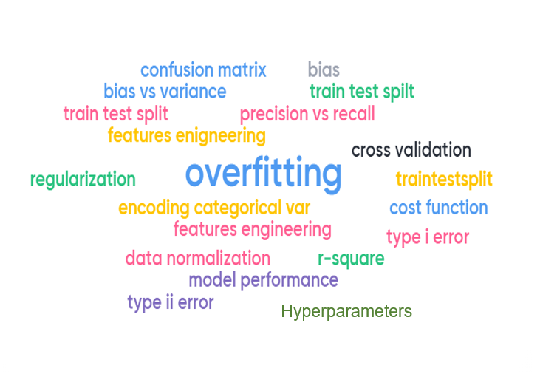
Common Terminology in Machine Learning

Slide 3
CIS Foundations of Machine Learning
Recap:
Linear Regression
Logistic Regression
Common Theme in Model Building (some)
Today:
Bias vs Variance TradeOff

Slide 4
Common Theme, Toolbox and Research workflow in Data Science
Apply different algorithms to solve different problems
based on the same theme and research workflow
Algorithms
SVM
KNN
Naïve Bayes
Neural Network
Logistics Regression
NLP
Problems
Regression
Classification
Recommendation System
Clustering
Association
Theme
Research Workflow
Toolbox

Slide 5
Common Theme, Toolbox and Research workflow in Data Science
Will use Linear Regression for many of the general practices in building models, some of them are
Split the dataset into training set and a testing set
Use standard metrics to judge model performance
K-fold cross validation
Bias-Variance tradeoff
Make sure we do not overfit

Slide 6
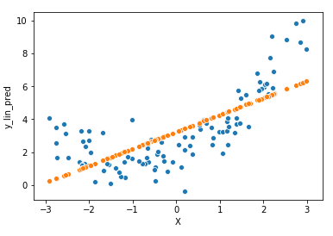
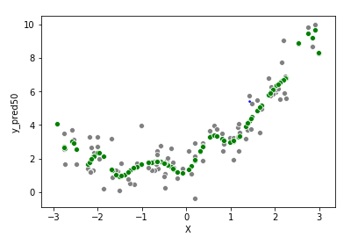
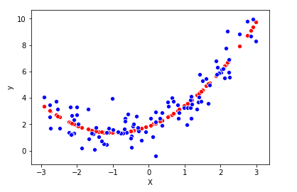
Lessons Learned from Polynomial Regression
Underfit
Overfit
Good fit
A more sophisticated model tends to have smaller errors in the training set, but can perform worse in testing dataset because it overfit
A too simplistic model will never be able to fit well on both the training set as well as the testing dataset

Slide 7
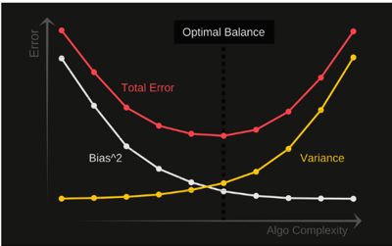
Bias vs Variance Tradeoff
White line is the error when applied to training datasets (in-sample datasets)
Yellow line is the error when applied to testing datasets (out-of-sample datasets)

Slide 8

How good are you at darts?

Slide 9
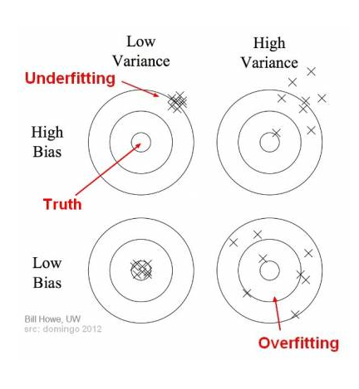
How good are you at darts?

Slide 10






Designing an airplane flying from DC to NY
Modeler | Design | Bias (low/high) | Variance (low/high) | Risk (over or underfit)
 |  | ? | ? | ?
 |  | ? | ? | ?
 |  | ? | ? | ?

Slide 11
Designing an airplane flying from DC to NY
Modeler | Design | Bias (low/high) | Variance (low/high) | Risk (over or underfit)
 |  | High | Low | underfit
 |  | Low | High | overfit
 |  | Low | Low | goodfit
https://www.youtube.com/watch?v=EuBBz3bI-aA&feature=youtu.be

